Slide 1

TRATTAMENTO MULTIMODALE NEL PREOPERATORIO: FARMACI E NUTRIZIONE
LUIGI SCHIAVO
DIPARTIMENTO DI MEDICINA, CHIRURGIA E ODONTOIATRIA
UNIVERSITA’ DEGLI STUDI DI SALERNO

Slide 2
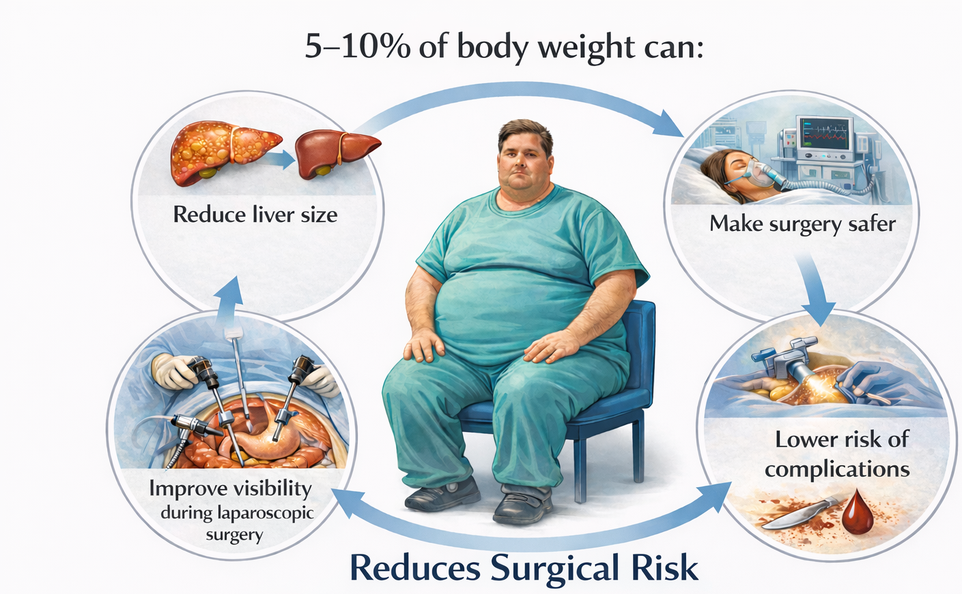


-
Preoperative Bariatric Surgery Weight Loss

Slide 3
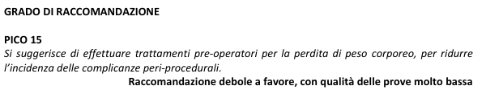
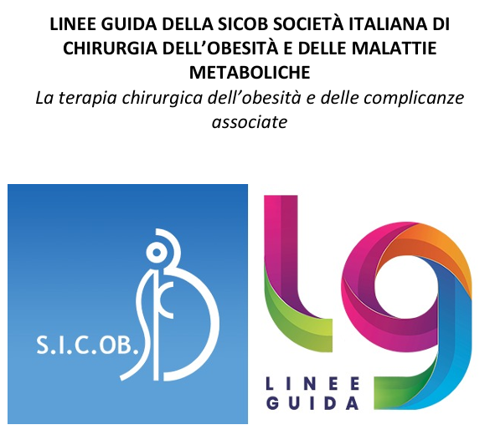
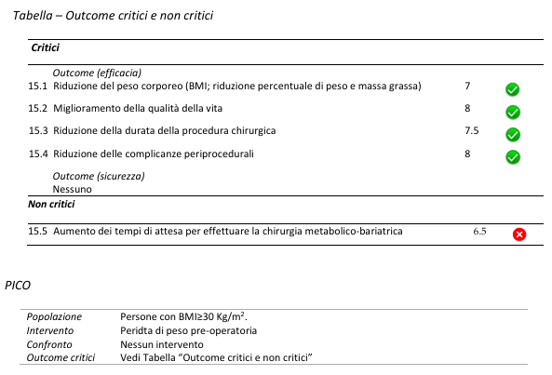
4 Trial (3 Diet, 1 BIB) - Obesity Class III

Slide 4

QUANTITY OF WEIGHT LOSS
QUALITY OF WEIGHT LOSS

Slide 5
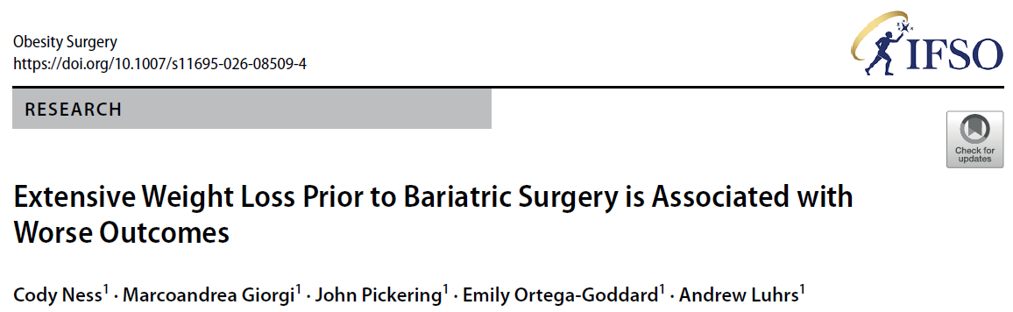
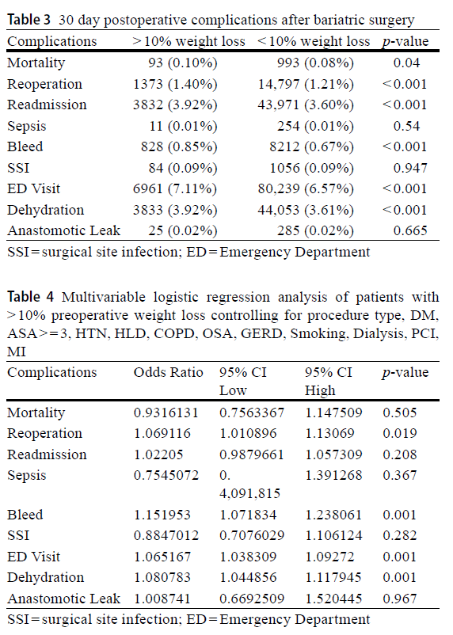
. 2026 Feb 7
(MBSAQIP) Metabolic and Bariatric Surgery Accreditation and Quality Improvement Program database from 2015 to 2021, which included over 1.3 million patients.
Patients who lost more than 10% of their highest preoperative weight were more likely to experience postoperative complications
....impaired tissue healing as a result of malnutrition from rapid weight loss

Slide 6
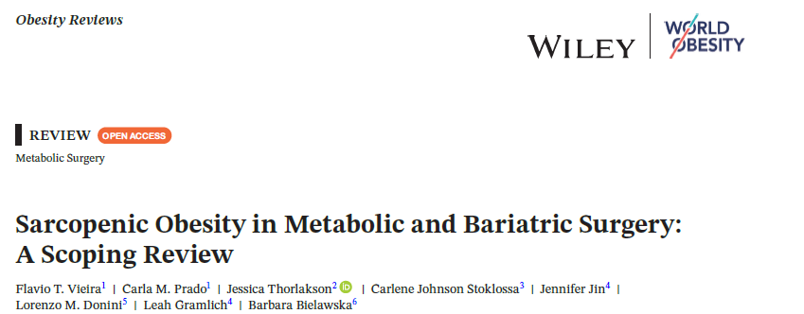
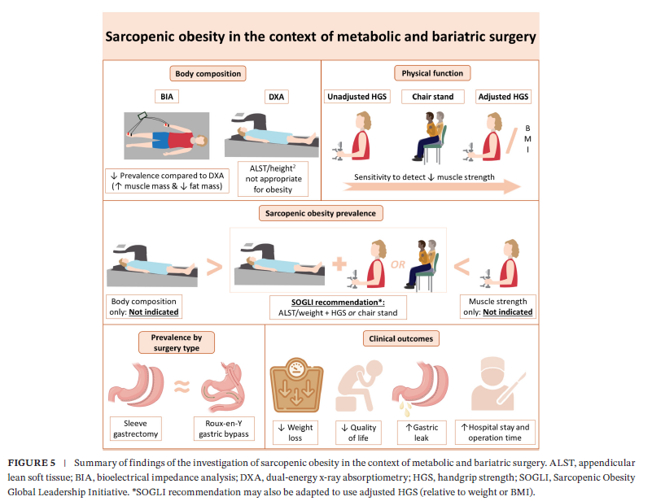

2025; 26:e13973 - https://doi.org/10.1111/obr.13973
M. Gaillard, H. et al. Preoperative Detection of Sarcopenic Obesity Helps to Predict the Occurrence of Gastric Leak After Sleeve Gastrectomy,” Obesity Surgery 28 (2018): 2379–2385.
Z.X. Shang- Guan, G. et al. Effect of Sarcopenic Obesity on Weight Loss Outcomes and Quality of Life After Laparoscopic Sleeve Gastrectomy: A Retrospective Cohort Study,” Obesity Surgery 34 (2024): 1479–1490.

Slide 7
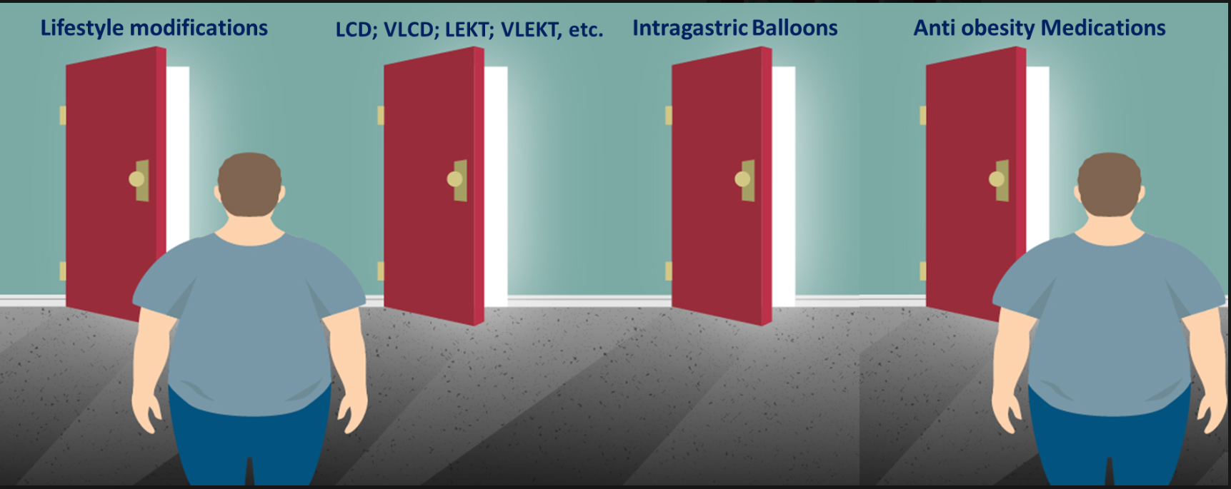
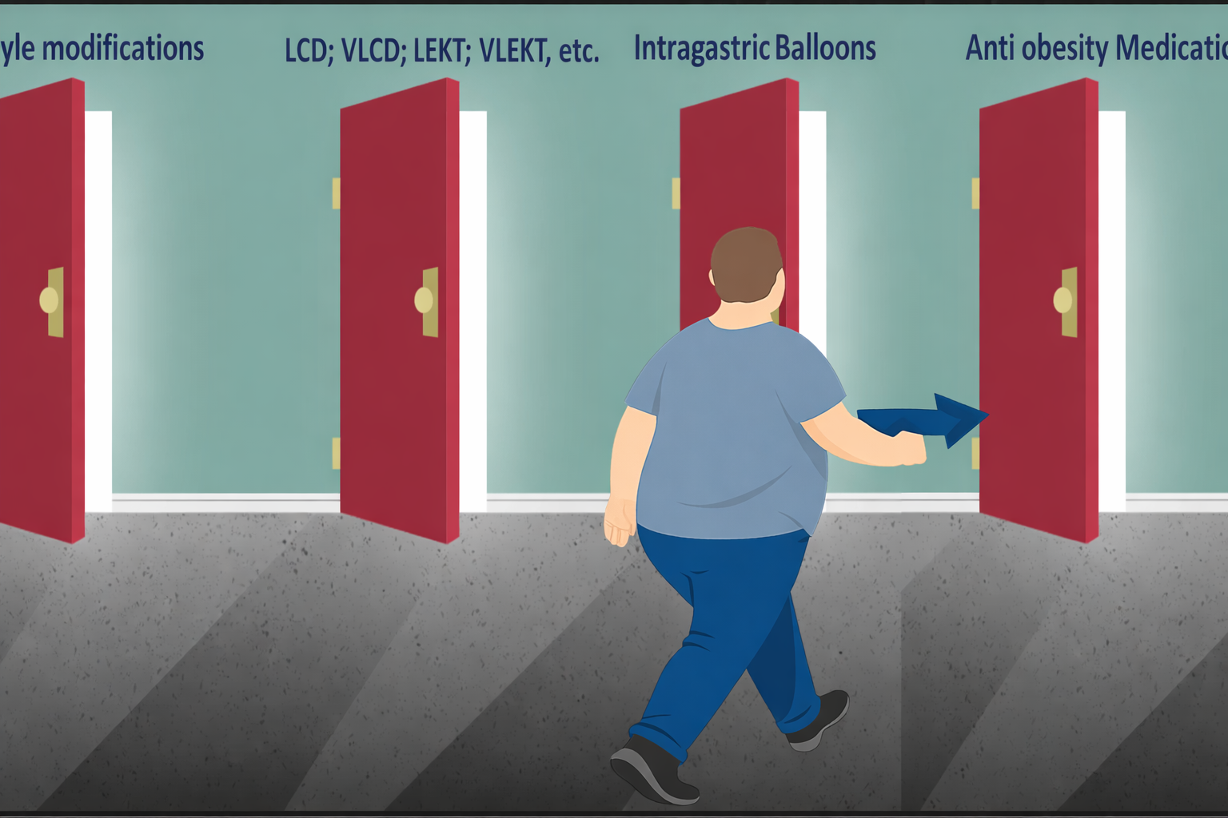

Slide 8
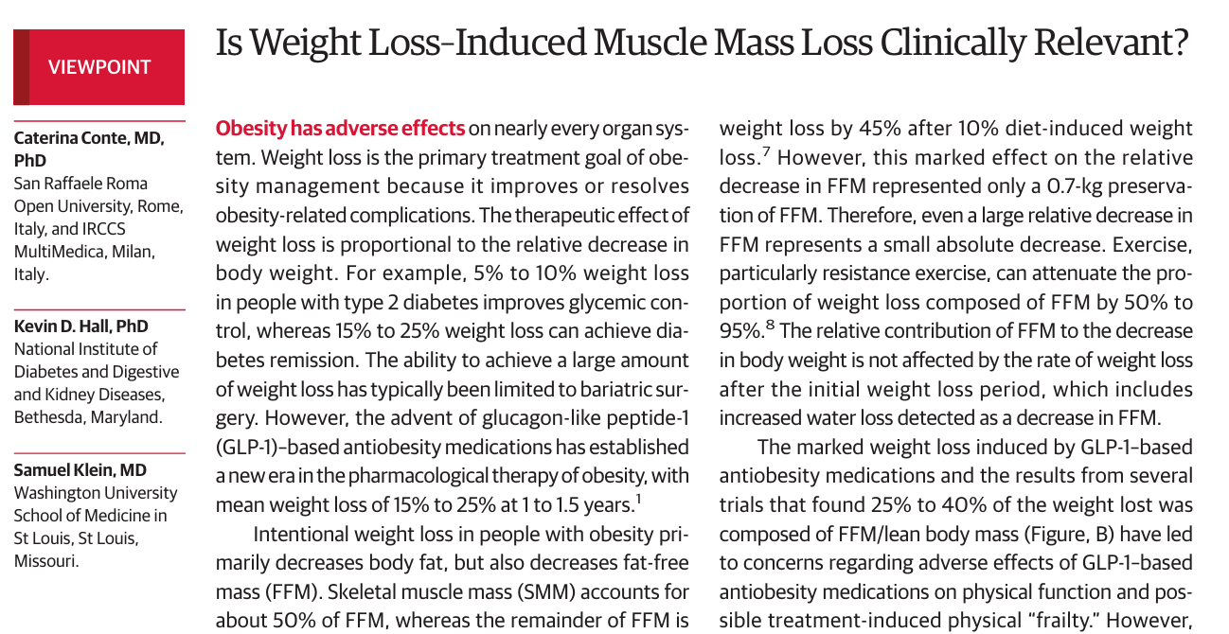
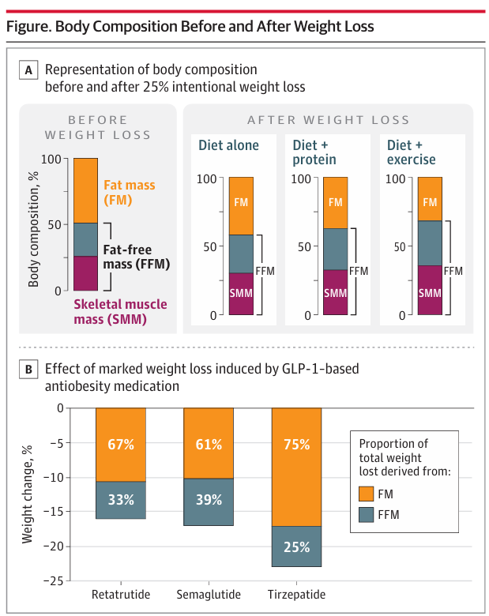
WEIGHT LOSS MAIN OBJECTIVE
TITOLO SLIDE
JAMA July 2, 2024 Volume 332, Number1
Several trials found 25% to 40% of the weight lost was composed of FFM have led to concerns regarding adverse effects of GLP-1–based anti-obesity medications on body composition changes
1:3

Slide 9
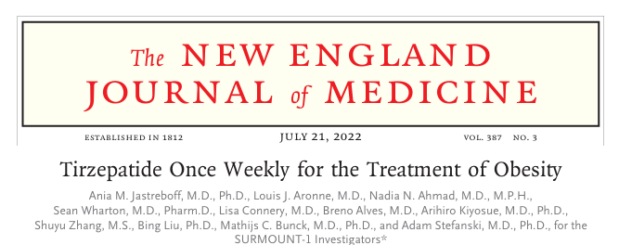
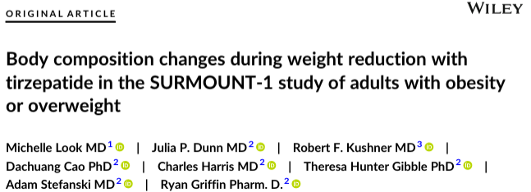
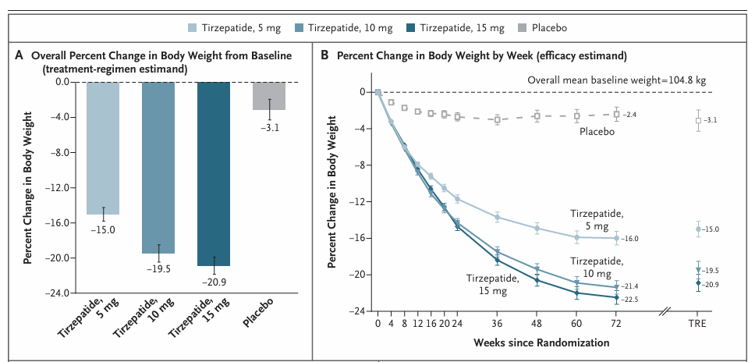
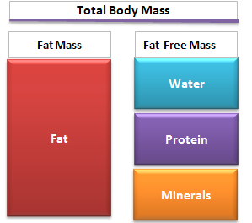
SURMOUNT 1 STUDY
Diabetes Obes Metab.2025;27:2720-29
LCD = - 500 calories per day
Therefore, preventive measures should be implemented early during TZP therapy to mitigate FFM loss and preserve MS and RMR
33.9%
10.9%

Slide 10
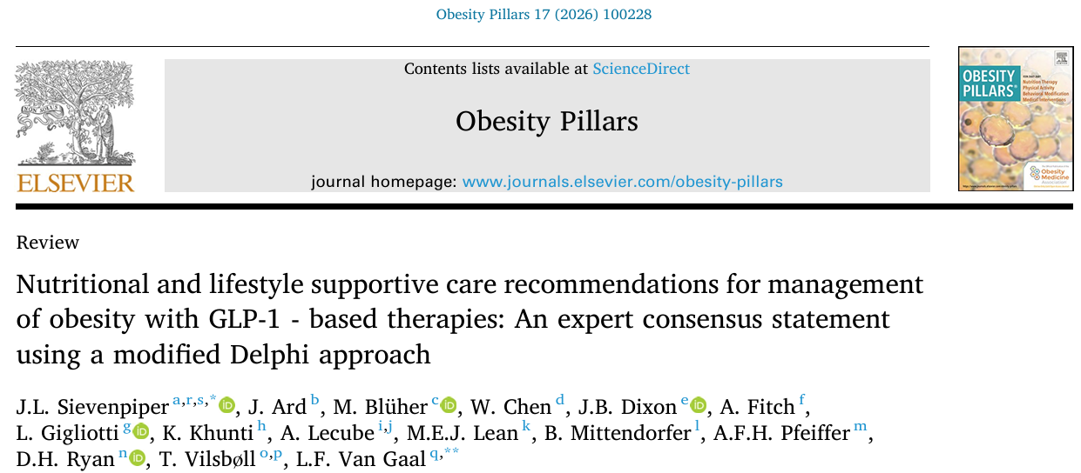
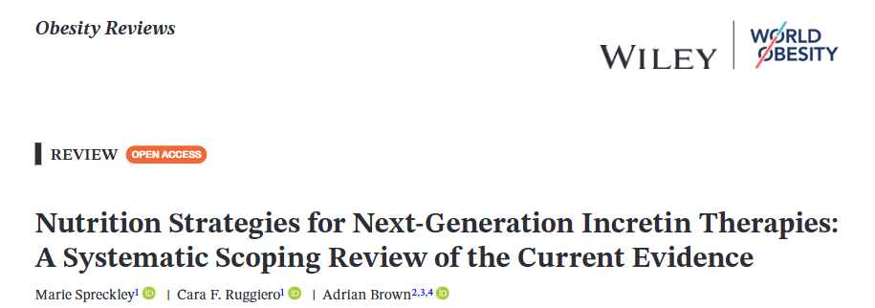
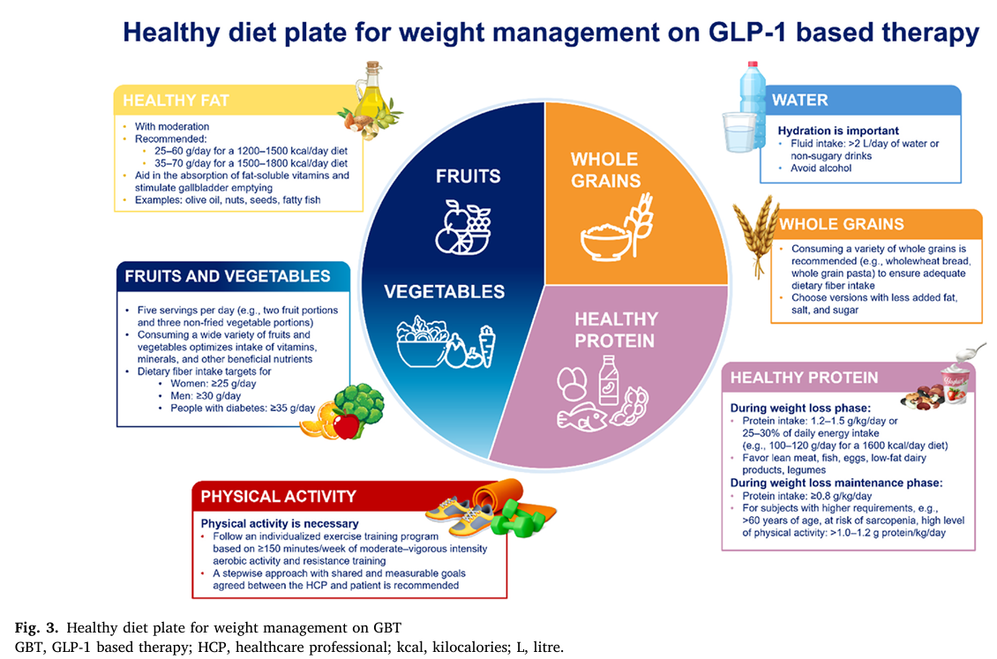
Obesity Pillars 17 (2026) 100228
2026; 0:e70079
Despite the effectiveness evidence on the quality of weight loss and on optimal dietary strategies is sparse.

Slide 11
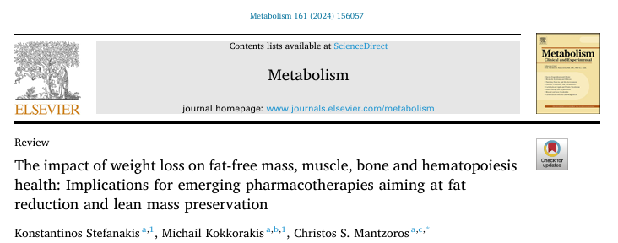
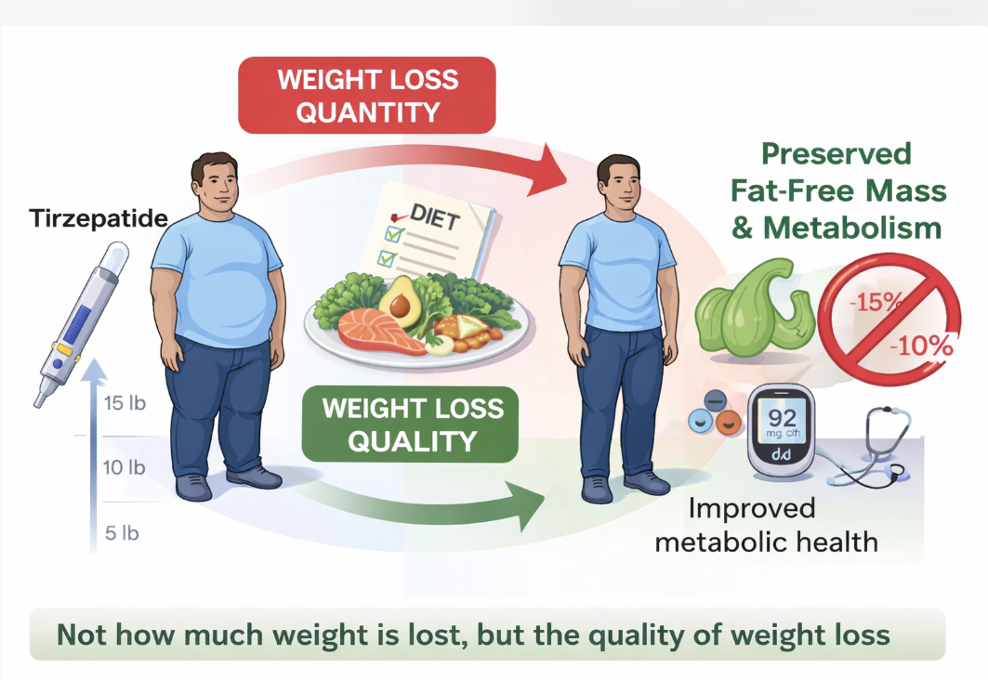
Metabolism 161 (2024) 156057

Slide 12
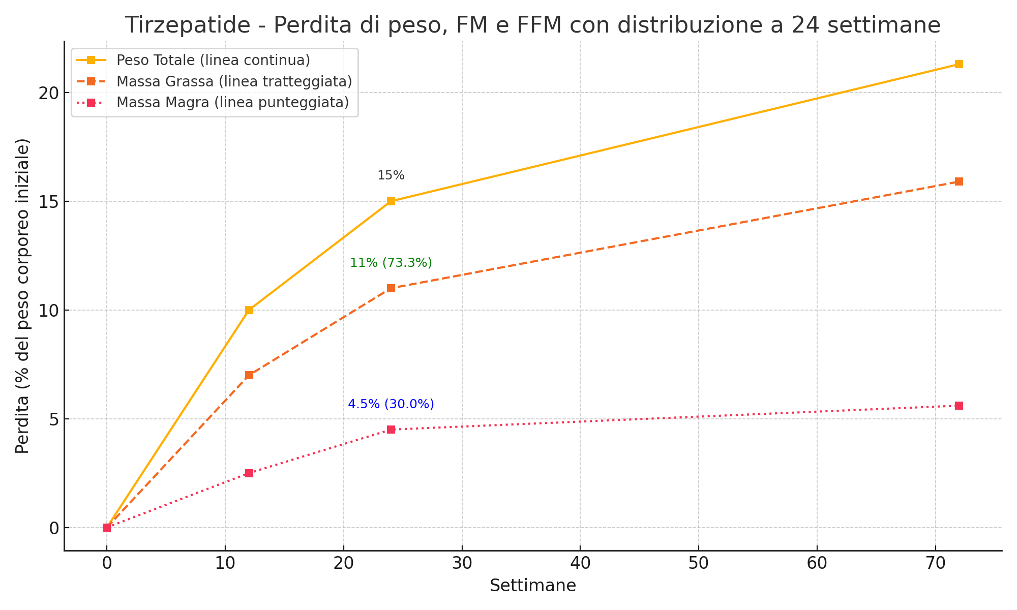
Reduction of FM (kg) after VLCKD. n Comparison of the mean difference in FM (kg) between VLCKD and controls.
SURMOUNT 1 STUDY
WEIGHT, FM and FFM LOSS AT 24 WEEKS
I valori tra parentesi mostrano la proporzione della perdita totale a 24 settimane
Rubino D, et al. NEJM 2021;384:989–1002
Wharton S, et al. Obesity (Silver Spring). 2023;31(6):1333–1342
Schiavo L, et al. Nutrients. 2025
Look M, et al. Diabetes Obes Metab. 2025;27:2720–2729
Tinsley GM, Heymsfield SB. J Endocr Soc. 2024;8(11):bvae164

Slide 13
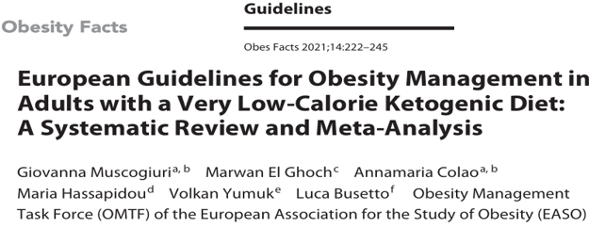
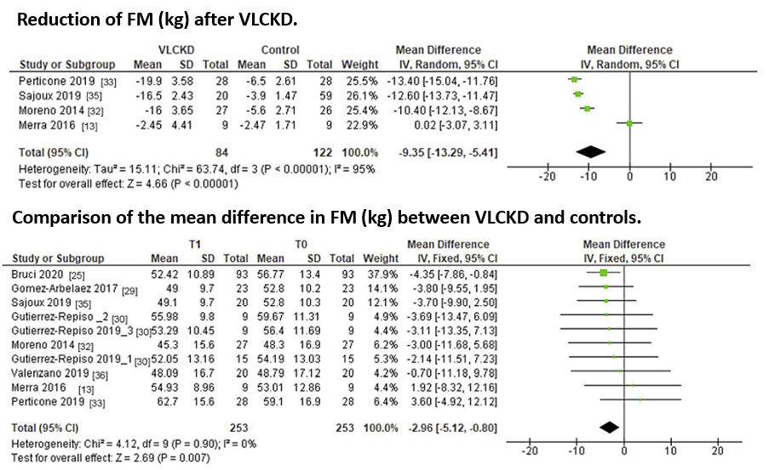
Reduction of FM (kg) after VLCKD. n Comparison of the mean difference in FM (kg) between VLCKD and controls.
SURMOUNT 1 STUDY
Compared to any weight loss intervention, a VLCKD showed superiority in the reduction of FM

Slide 14
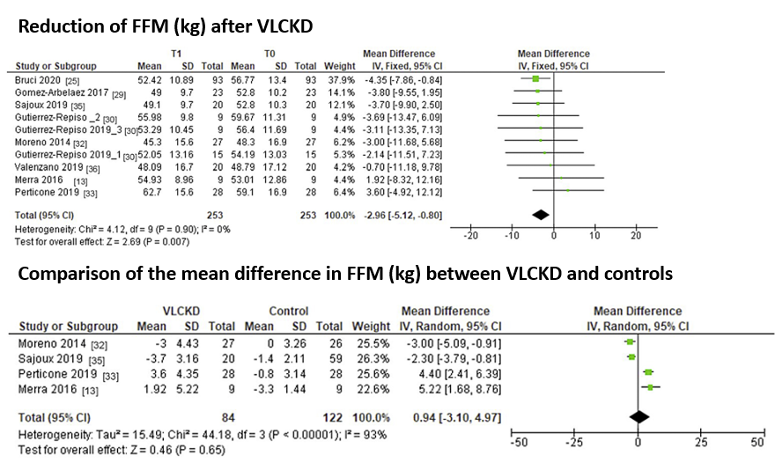
p Comparison of the mean difference in FFM (kg) between VLCKD and controls.
SURMOUNT 1 STUDY
no significant difference
on the reduction in FFM

Slide 15
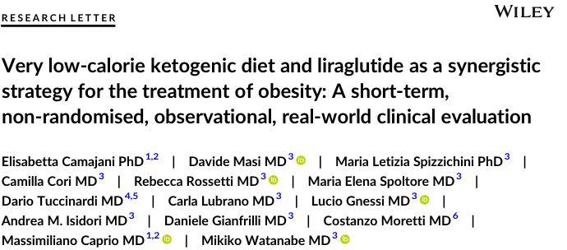
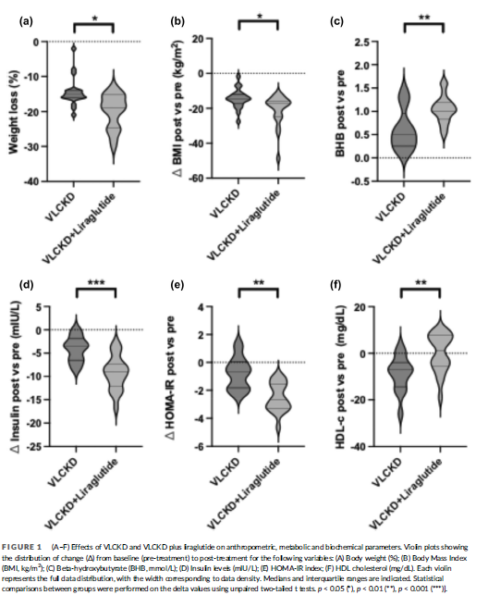
DiabetesObesMetab.2025;27:6078–6083
NAPOLI

Slide 16
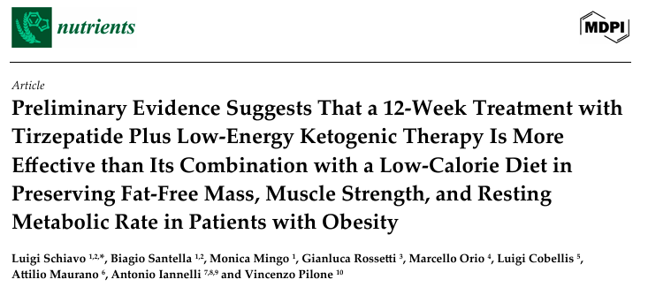
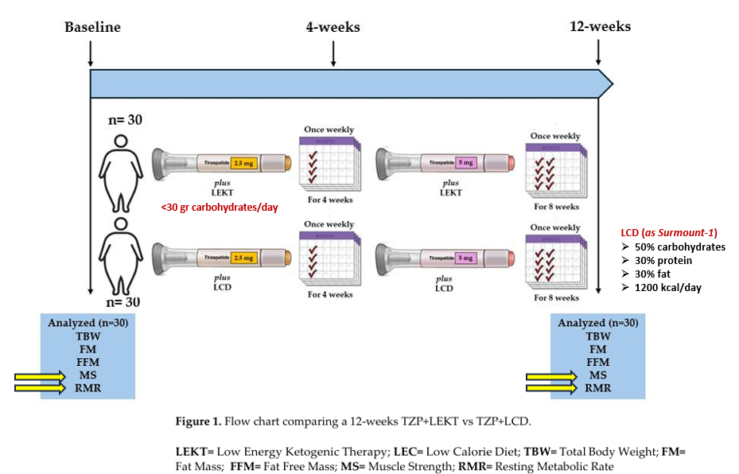
2025, 17, 1216
SURMOUNT 1 STUDY

Slide 17
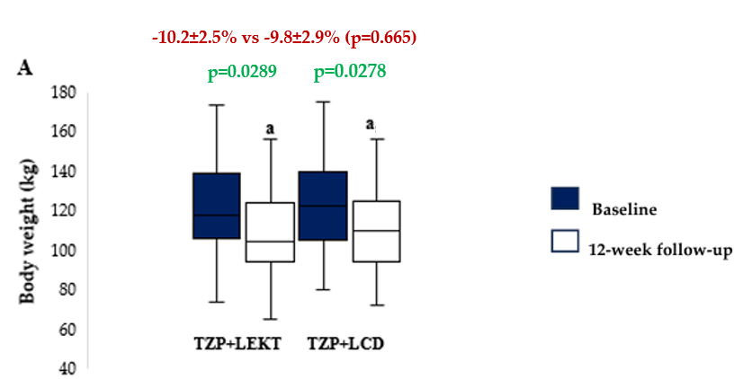
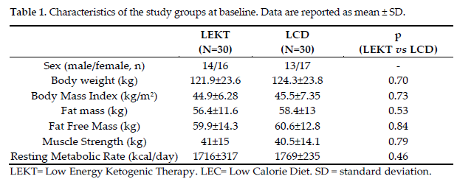
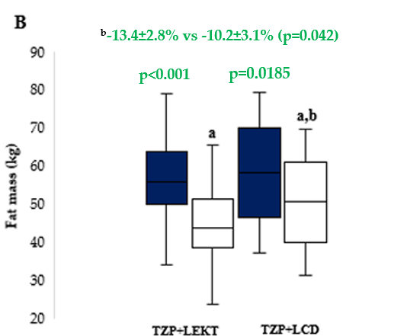
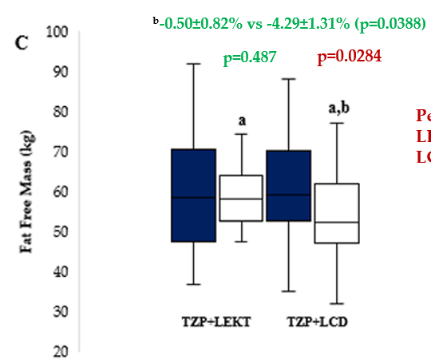
SURMOUNT 1 STUDY
RESULTS
Figure 2. Box plots showing baseline and 12-week follow-up changes in body weight (A), fat mass (B), and fat free mass (C) in both groups study. The horizontal bars represent the median values. Lower and upper boundaries of the box represent the first and the third quartile, respectively. Lower and upper error bars represent the minimum and the maximum value, respectively.
ª12-week follow-up vs baseline
^{b}12-week follow-up TZP+LEKT vs LCD

Slide 18
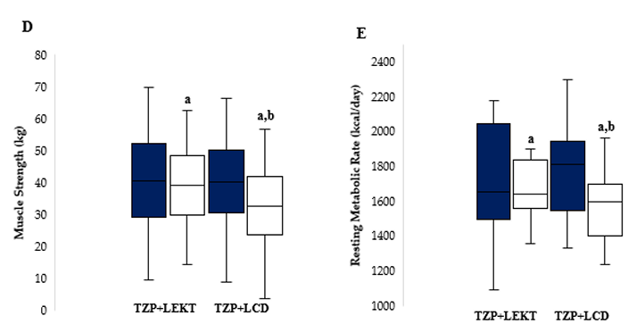
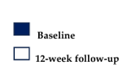
SURMOUNT 1 STUDY
RESULTS
^{b}-0.3±0.9% vs -4.1±1.2% (p=0.046)
^{b}-1.2±0.9% vs -5.3±1.8% (p=0.019)
p=0.691
p=0.0341
p<0.001
p=0.263
Figure 2. Box plots showing baseline and 12-week follow-up changes in muscle strength (D) and resting metabolic rate (E) in both groups study. The horizontal bars represent the median values. Lower and upper boundaries of the box represent the first and the third quartile, respectively. Lower and upper error bars represent the minimum and the maximum value, respectively.
ª12-week follow-up vs baseline
^{b}12-week follow-up TZP+LEKT vs LCD

Slide 19
SURMOUNT 1 STUDY ANALYSIS AT 12 WEEK
SURMOUNT 1 STUDY
LCD = - 500 calories per day
72w
72w
33.9%
10.9%
12w
12w
8.5%
vs
13.4%
our study (LEKT)
1.9%
vs
0.5%
our study (LEKT)

Slide 20
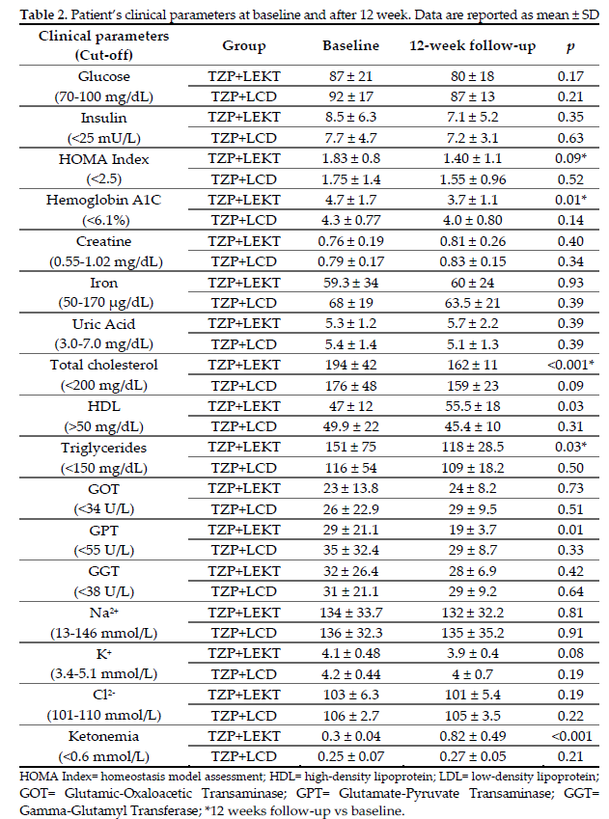
SURMOUNT 1 STUDY
RESULTS

Slide 21
SURMOUNT 1 STUDY
PROPOSED MECHANISMS OF FFM, MS, AND RMR PRESERVATION BY LEKT
+
WEIGHT LOSS BY LEKT
FIBROBLAST GROWTH
FACTOR 21
Keton bodies
+
-
-
+
MITOCOND. EFFICIENCY &
LIPID OXIDATION
GLUCONEO-
GENESIS
MYOSTATIN
MUSCLE STRENGTH
+
-
MUSCLE PROTEOLYSIS
PROTEIN
SYNTHESIS
PROTEOLISYS
+
+
-
+
+
FFM PRESERVATION
MUSCLE MAINTENANCE
PI3K/Akt/mTOR Pathway
+
+
+
MITOCOND. BIOGENESIS
+
ENERGY EFFICIENCY
AMPK
&
PGC-1α
+
RESTING METABOLIC RATE
OXIDATIVE METABOLISM

Slide 22
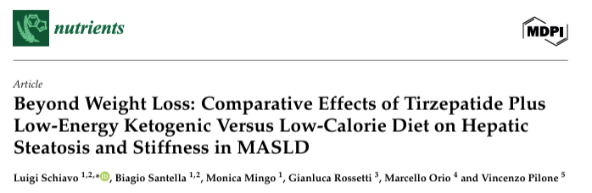
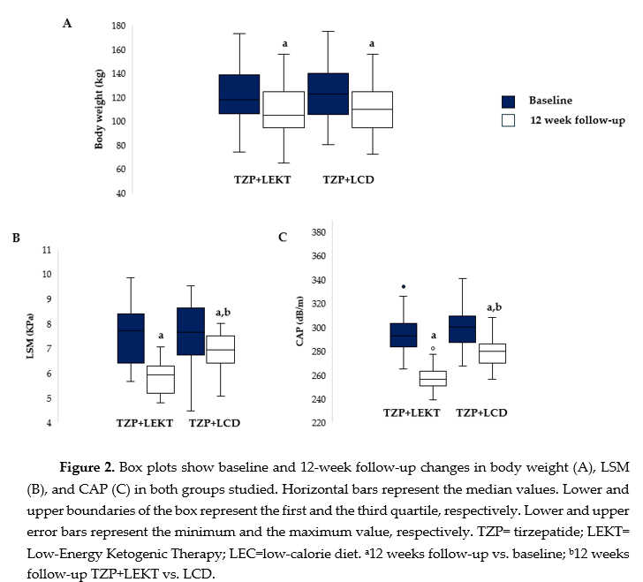
2025 Jul 24;17(15):2409

Slide 23
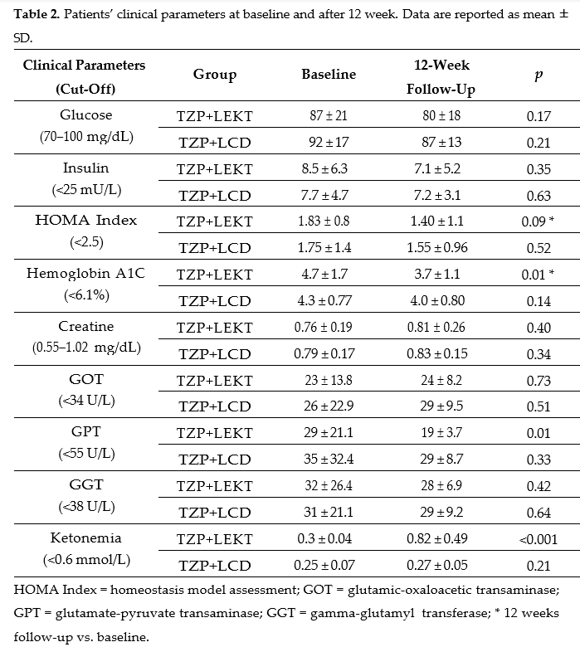
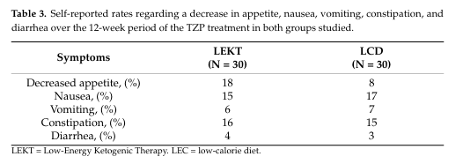
RESULTS
SURMOUNT 1 STUDY

Slide 24
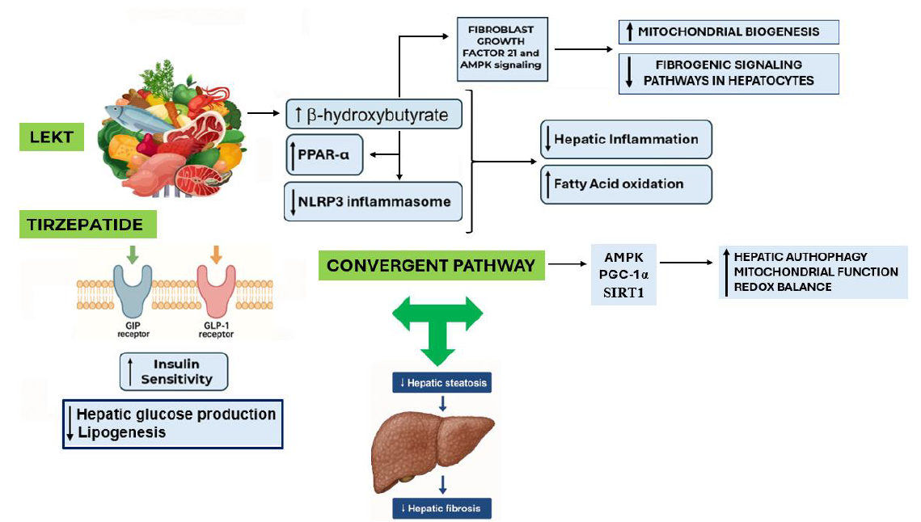
Proposed Synergistic Mechanisms of TZP and LEKT in MASLD
SURMOUNT 1 STUDY

Slide 25
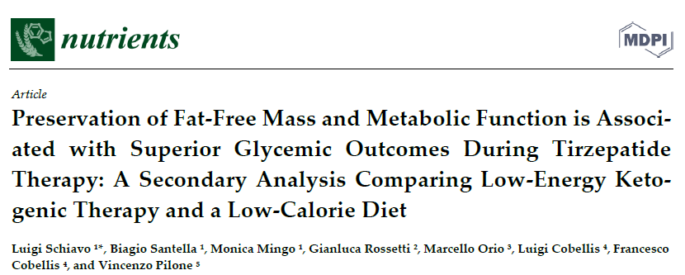

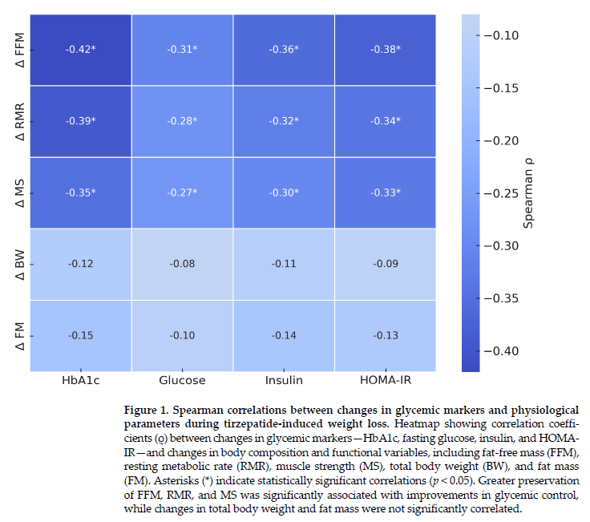
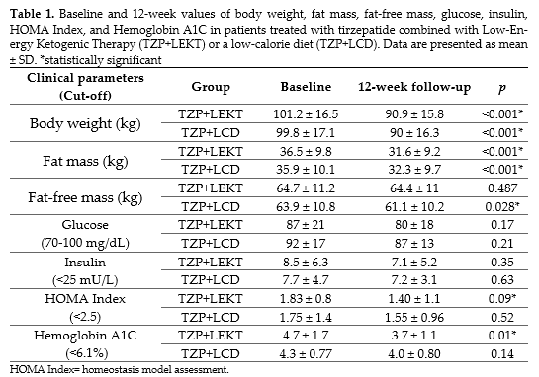
−10.2%
−9.8%
−13.4%
−10.0%
−0.5%
−4.4%
−8.0%
−5.4%
−16.5%
−6.5%
−23.5%
−11.4%
−21.3%
−7.0%
This secondary analysis aimed to determine whether the preservation of FFM, during TZP-induced weight loss is associated with more favorable glycemic outcomes, independent of total weight loss magnitude

Slide 26
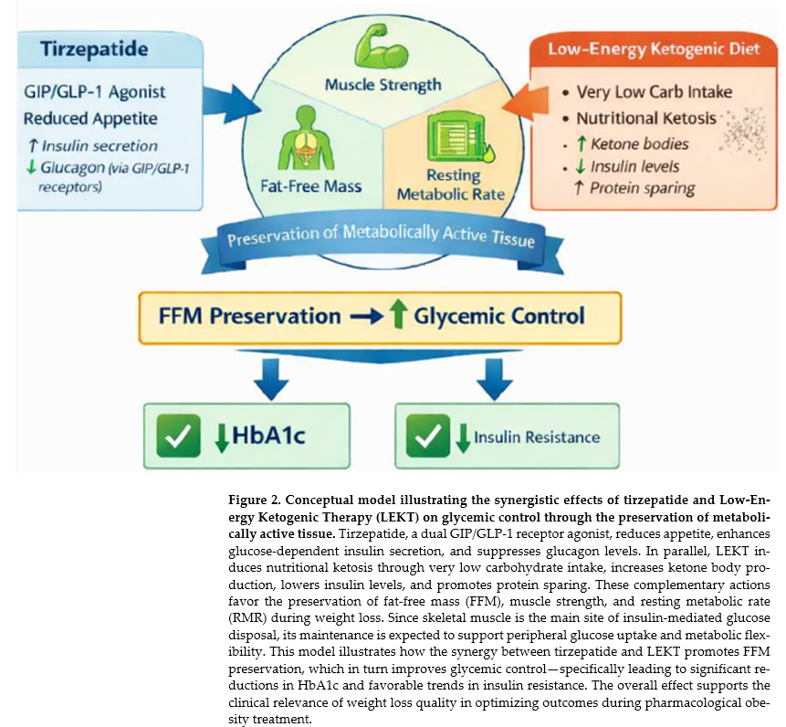

Poiché il muscolo scheletrico rappresenta il principale sito di captazione del glucosio mediata dall’insulina, il suo mantenimento è atteso supportare la captazione periferica del glucosio e la flessibilità metabolica.
SURMOUNT 1 STUDY

Slide 27
CONCLUSIONS:
Patients who lost more than 10% of their highest preoperative weight were more likely to experience postoperative complications
TZP+LEKT seems to be superior to TZP+LCD in promoting FM reduction while preserving FFM, MS, and RMR in patients with obesity, and in promoting CAP and LSM reduction in patients with MASLD, and in enhanced glycemic outcomes, indipendently of weight loss magnitude

Slide 28
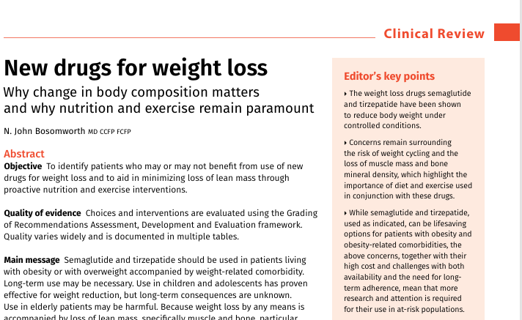
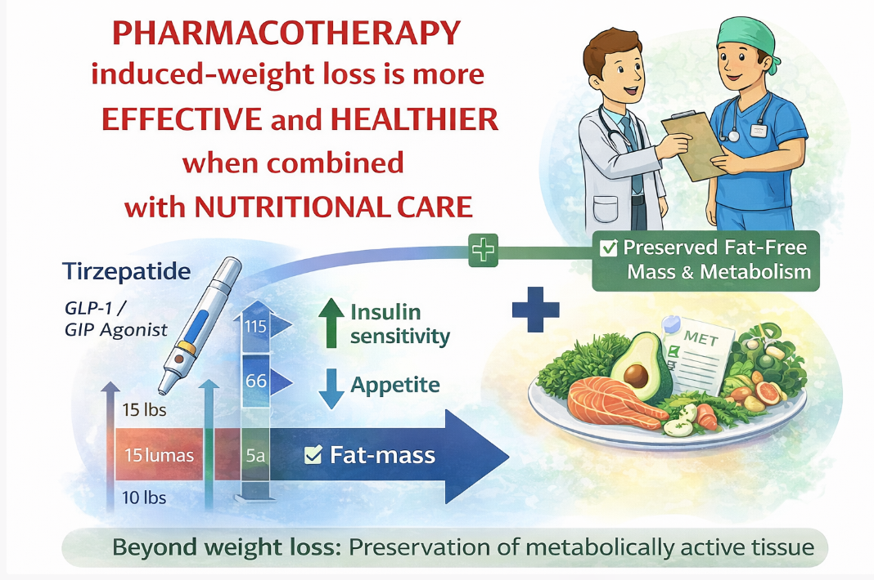
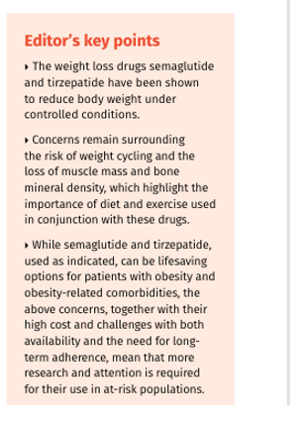
SURMOUNT 1 STUDY
2025 Nov-Dec;71(11-12):705-714.
TAKE-HOME MESSAGE

